Slide 1
GIFCO Logistics Leaders, Freight Dealers Since 1971
Mona Ghorayeb
MSBA – Capston Project
202152440

Slide 2
Introduction
Context
Logistics and freight forwarding are rapidly evolving due to global interconnectedness, customer expectations, and technological innovation.
Despite Lebanon’s strategic location and trade access, fewer than 15% of local firms analyze their data systematically (West Bank, 2023).
Objectives
Support GIFCO in moving from intuition-based to data-driven decision-making.
Provide visibility into historical performance (2019–2024) and forecast future growth (next 6 years) to enable smarter strategic planning related to expansion and investment gathering.

Slide 3
About GIFCO
Services
Achievements
Accreditation
Offers logistics solutions by land, sea, and air.
Offers warehousing / storage.
Founded in 1971, based in Lebanon with operations in Juba.
Over 684,000 shipments delivered.
Delivered to around 77,000 customers.
Accredited to different worldwide logistics network:
WCA
Atlas
IATA
Others

Slide 4

Problem Statement
Analytics Gap
GIFCO lacks the infrastructure and expertise to analyze historical performance or predict future trends using data.
Deriving Insights
Drive key business decisions: expansion planning and investment gathering which are currently based on intuition and fragmented Excel reports.
Project Solution
This project bridges the gap by introducing a scalable, analytics-driven framework that enables forecasting, strategic insights, and data-backed growth planning.

Slide 5

Litterature Review
DB Schenker implemented advanced forecasting models such as SARIMA, Prophet, and XGBoost, resulting in a 25% improvement in sales forecast accuracy and better regional planning.
C.H. Robinson adopted real-time analytics to monitor route efficiency and shipment data, enabling them to redesign their delivery network and enhance customer satisfaction.
DHL leveraged predictive analytics through its Resilience360 platform to monitor global risks, anticipate disruptions, and reroute shipments, significantly improving supply chain resilience and customer reliability.
The PyCaret Theta model has been successfully used in logistics case studies to predict volume spikes and seasonal fluctuations, offering better accuracy and deployment speed compared to traditional models (Schmid et al., 2022).

Slide 6
Data Overview
The company provided 2 kinds of datasets: sales data and shipment details data.
Sales Data
Rows: 13,755 observations
Features: Product information (Family, Product Name…), client details (Client Name, City, Branch,…), sales metrics (Gross/Net Amount USD, Quantity…), temporal fields (Date, Year, Invoice…)
Shipment Data
Rows: 12,536 observations
Features: Logistics details (Freight Type, Family, Commodity, Packages…), client and route information (Client, From, To, Shipper, Vessel…), operational attributes (Shipment No., Date, Branch)
Data Fixes
Initial issues: missing values, duplicates, inconsistent formats.
Data cleaning and feature engineering performed in Python.

Slide 7
Methodology
01
02
03
04
05
Data Preprocessing
EDA & Tableau
Forecasting Models
Model Evaluation & Selection
Deployment via Streamlit
Cleaned and structured raw sales and shipment data to make it ready for analysis.
Identified historical trends, seasonality, and profit drivers to understand GIFCO’s performance baseline.
Applied multiple forecasting models to predict future sales.
Chose the most accurate model (Theta) through RMSE for reliable forecasting and investment planning.
Delivered an interactive dashboard enabling management to explore trends and expansion options.
How was the problem solved?
Transformed raw operational data into actionable insights through cleaning, analysis, and Tableau dashboard which showcased sales trends and expansion insights.
Empowering management with a forecasting tool to support data-driven decisions on expansion, valuation, and investment.

Slide 8
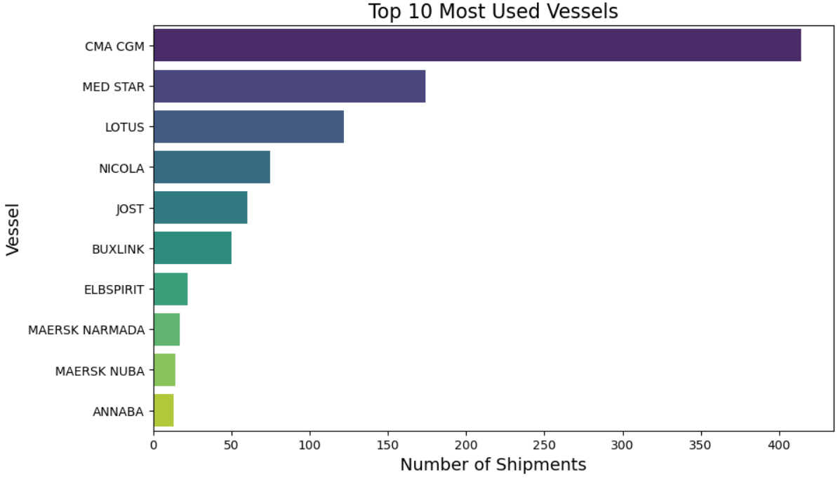
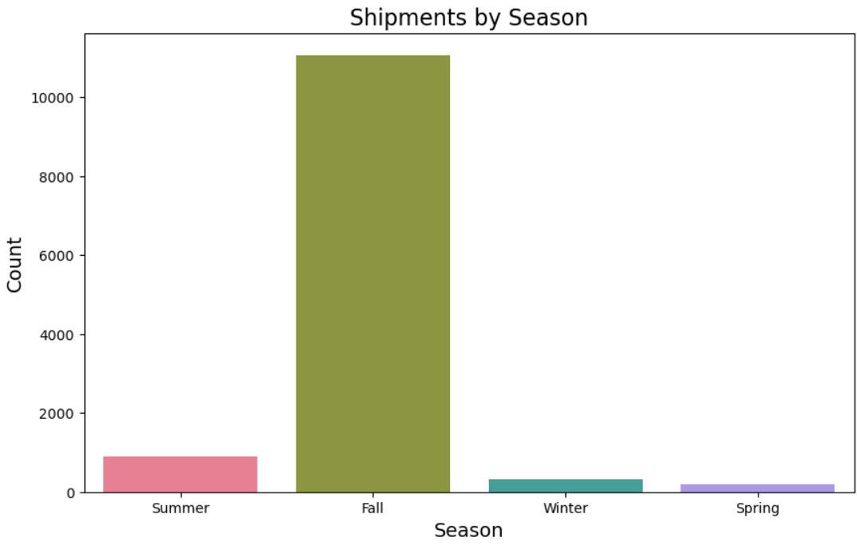
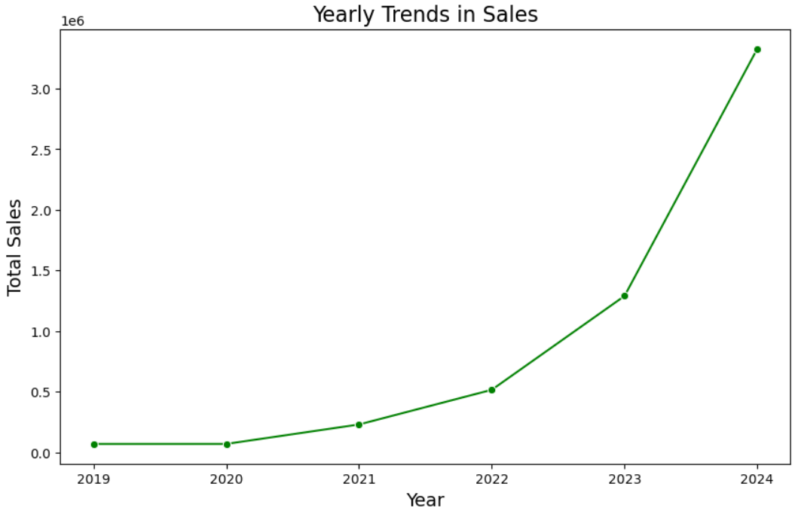
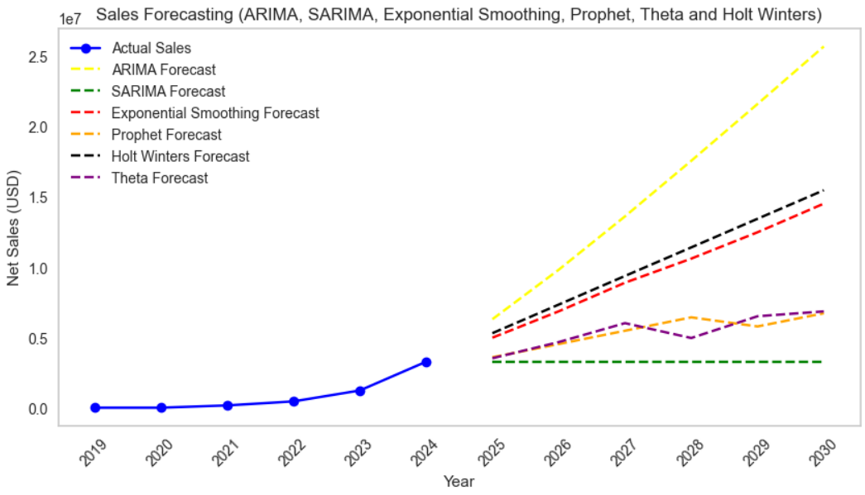
1. Exploratory Data Analysis (EDA)
Used Python (pandas, seaborn, matplotlib) to clean the data and explore trends, seasonality, profit margins, and freight performance.
Generated visual insights on product families, client distribution, and year-over-year sales changes.
2. Forecasting Models
Compared different forecasting models: ARIMA, SARIMA, Prophet, Holt-Winters, and Theta.
Selected Theta model based on lowest RMSE: around $230,000, offering the most accurate 6-year forecast.

Slide 9
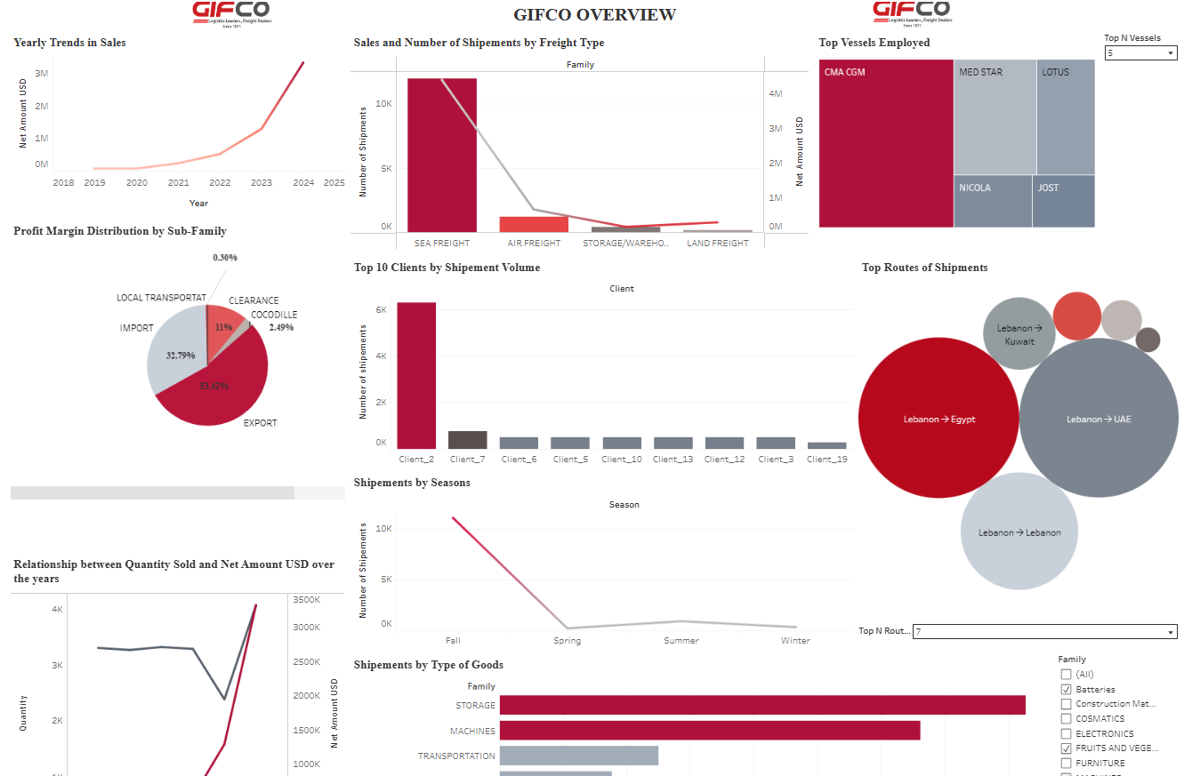
3. Overview Dashboard
using Tableau.

Slide 10
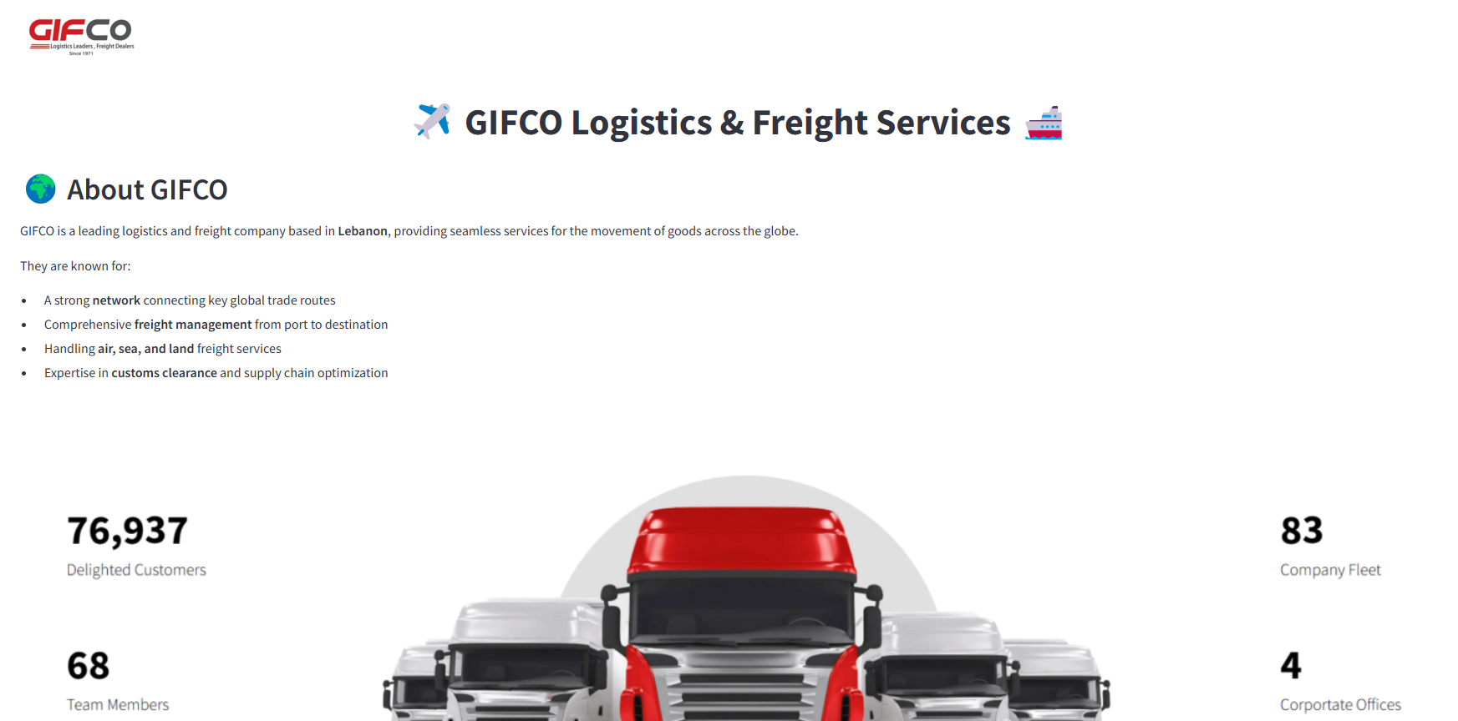
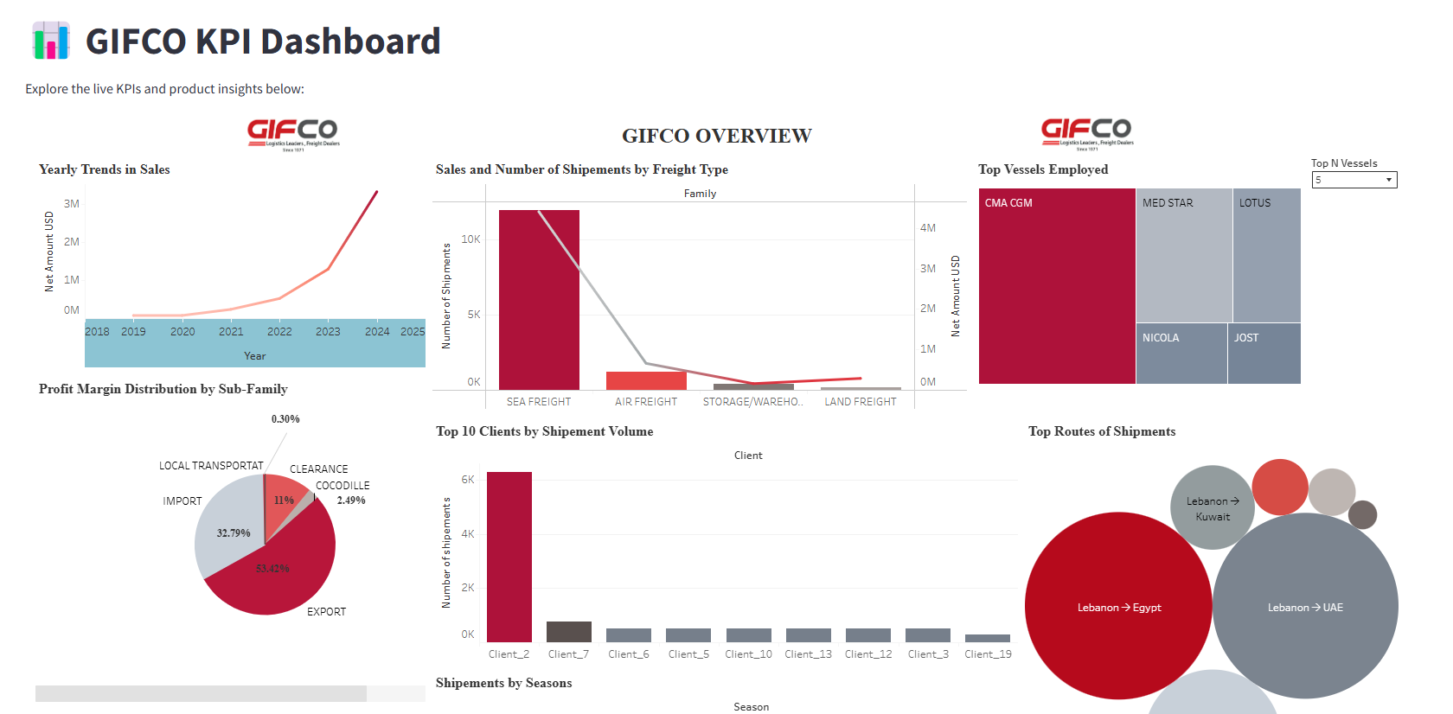
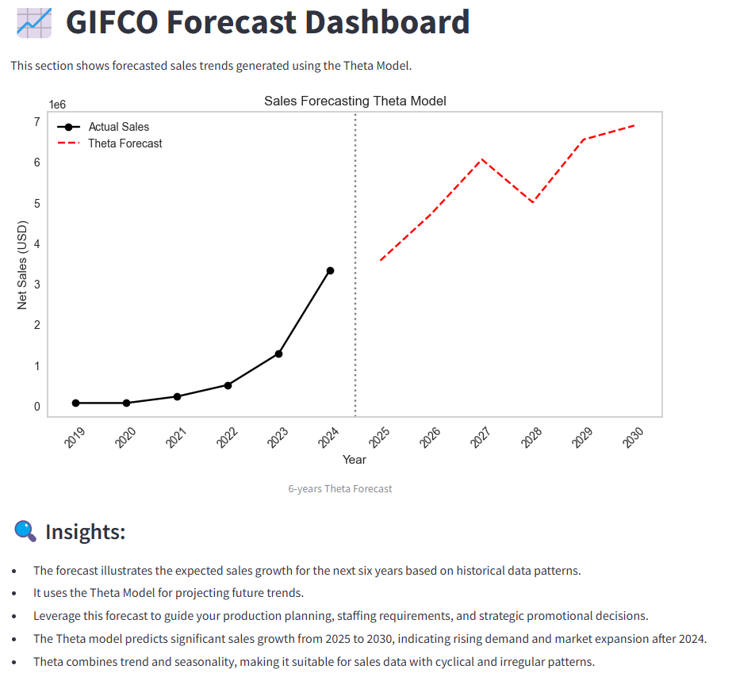
4. Streamlit Web App
GIFCO Overview
Tableau Dashboard
Sales Forecasting
Home Page
KPI Dashboard
Forecasting

Slide 11
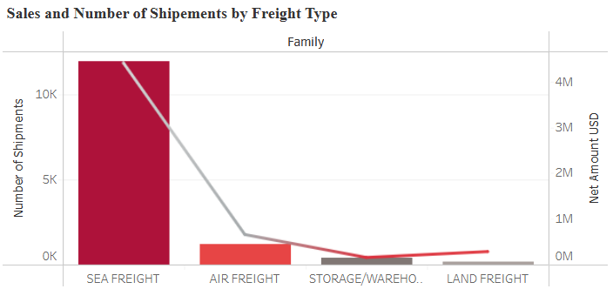
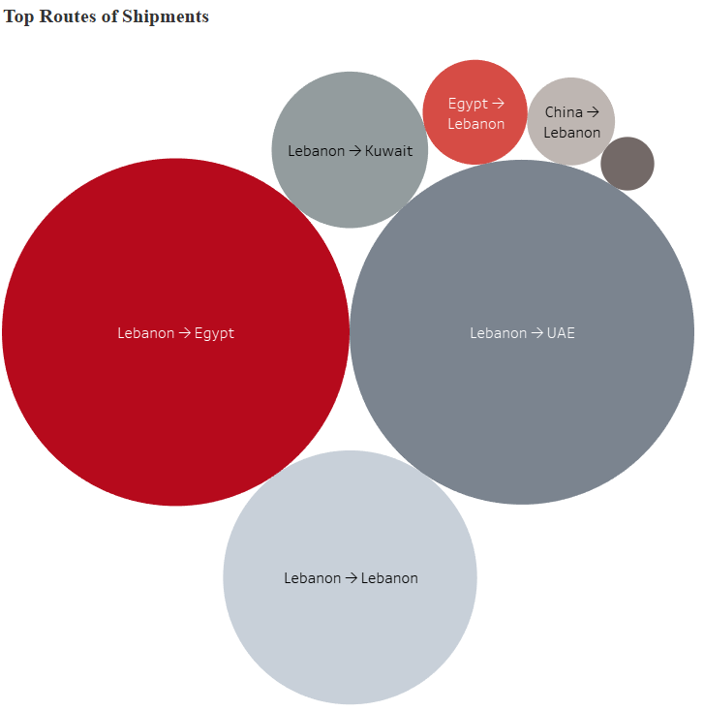
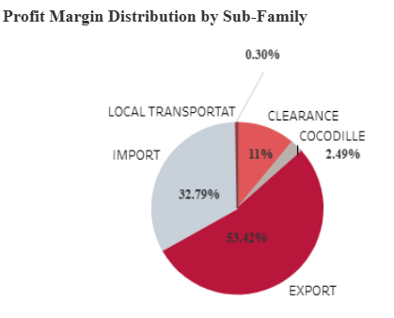
Key Results
For geographical expansion, their shipments inward and outward are mostly from and to Egypt and UAE. So, opening new offices in both Egypt and UAE are advisable.
GIFCO’s profit are centered mostly from sea freights and more importantly from exports.

Slide 12
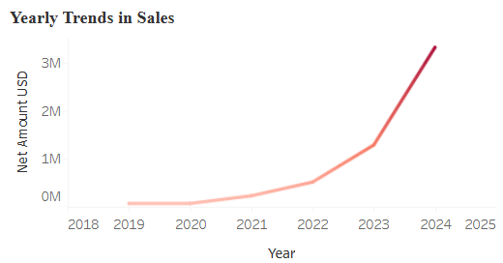
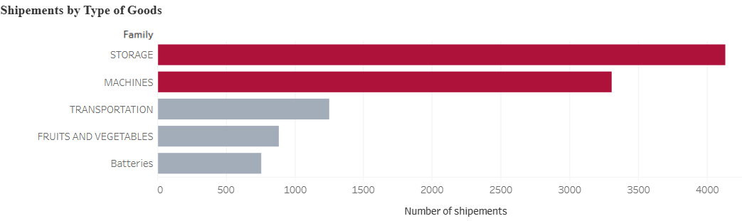
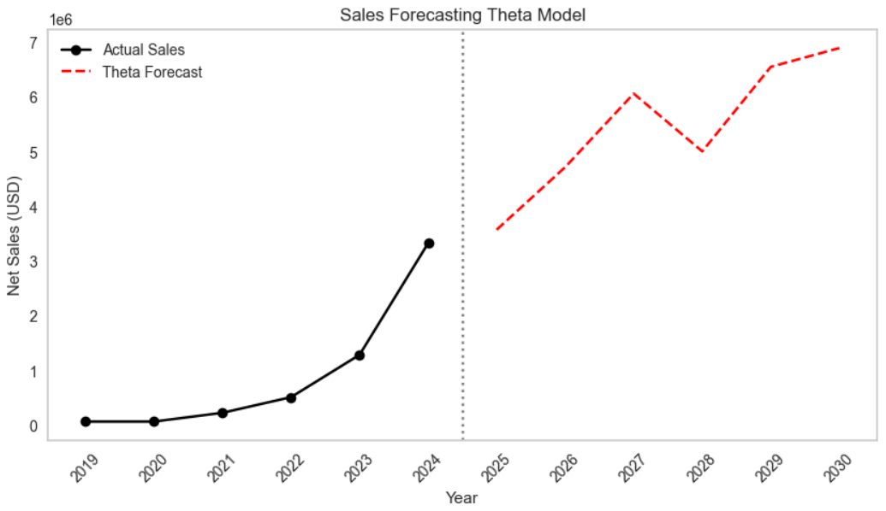
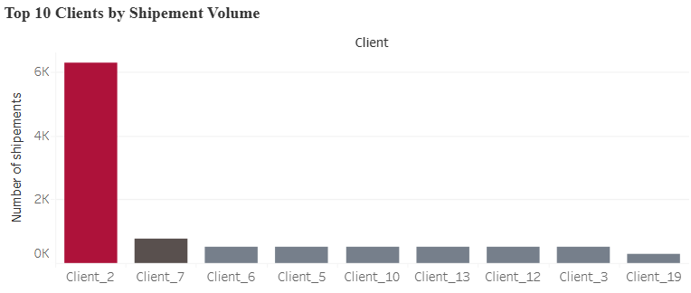
Key Results
GIFCO’s sales trend from 2019-2024 has an increasing trend. In the forecast, investors can also see an increasing forecast trend in the next 6-years → driving new investments.
GIFCO’s strategy can be shaped based on these findings:
Existing client base is a big profit generator. So instead of always seeking new clients, they can tap into an existing profit.
Focus on storage and warehousing as much as exports → generates most income.

